Slide 1
Constraint Satisfaction Problems
Chapter 5
Section 1 – 3
4 Feb 2004
CS 3243 - Constraint Satisfaction

Slide 2
Outline
Constraint Satisfaction Problems (CSP)
Backtracking search for CSPs
Local search for CSPs
4 Feb 2004
CS 3243 - Constraint Satisfaction

Slide 3
Constraint satisfaction problems (CSPs)
Standard search problem:
CSP:
Allows useful general-purpose algorithms with more power than standard search algorithms
state is defined by variables Xi with values from domain Di
goal test is a set of constraints specifying allowable combinations of values for subsets of variables
Simple example of a formal representation language
state is a "black box“ – any data structure that supports successor function, heuristic function, and goal test
4 Feb 2004
CS 3243 - Constraint Satisfaction

Slide 4

Example: Map-Coloring
Variables WA, NT, Q, NSW, V, SA, T
Domains D_{i} = {red,green,blue}
Constraints: adjacent regions must have different colors
e.g., WA ≠ NT, or (WA,NT) in {(red,green),(red,blue),(green,red), (green,blue),(blue,red),(blue,green)}
4 Feb 2004
CS 3243 - Constraint Satisfaction

Slide 5

Example: Map-Coloring
Solutions are complete and consistent assignments, e.g., WA = red, NT = green,Q = red,NSW = green,V = red,SA = blue,T = green
4 Feb 2004
CS 3243 - Constraint Satisfaction

Slide 6

Constraint graph
Binary CSP: each constraint relates two variables
Constraint graph: nodes are variables, arcs are constraints
4 Feb 2004
CS 3243 - Constraint Satisfaction

Slide 7
Varieties of CSPs
Discrete variables
  finite domains:
    n variables, domain size d → O(d ^{n}) complete assignments
    e.g., Boolean CSPs, incl.~Boolean satisfiability (NP-complete)
  infinite domains:
    integers, strings, etc.
    e.g., job scheduling, variables are start/end days for each job
    need a constraint language, e.g., StartJob₁ + 5 ≤ StartJob₃
Continuous variables
  e.g., start/end times for Hubble Space Telescope observations
  linear constraints solvable in polynomial time by linear programming
4 Feb 2004
CS 3243 - Constraint Satisfaction

Slide 8
Varieties of constraints
Unary constraints involve a single variable,
  e.g., SA ≠ green
Binary constraints involve pairs of variables,
  e.g., SA ≠ WA
Higher-order constraints involve 3 or more variables,
  e.g., cryptarithmetic column constraints
4 Feb 2004
CS 3243 - Constraint Satisfaction

Slide 9
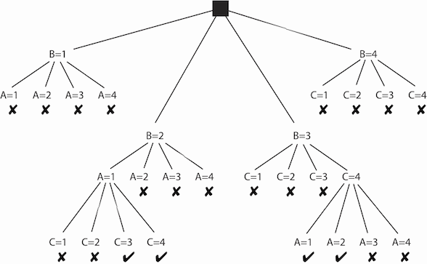
Examples
Suppose you have a CSP with the variables A, B, and C, each with domain {1,2,3,4}. Suppose the constraints are A<B and B<C
4 Feb 2004
CS 3243 - Constraint Satisfaction

Slide 10
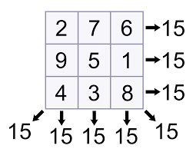
Examples
4 Feb 2004
CS 3243 - Constraint Satisfaction

Slide 11
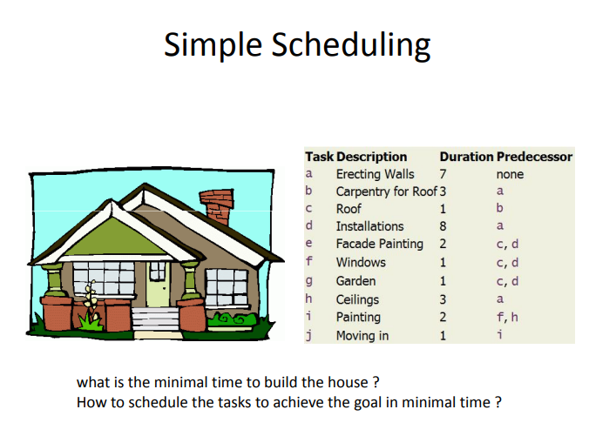
Examples
4 Feb 2004
CS 3243 - Constraint Satisfaction

Slide 12
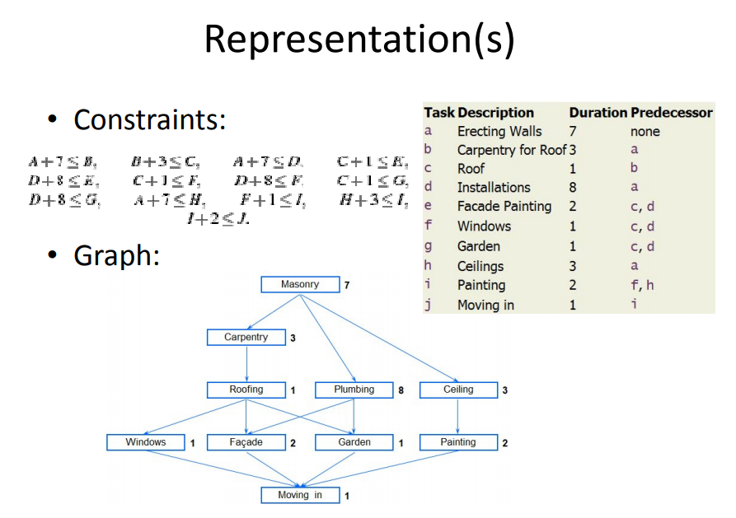
Examples
4 Feb 2004
CS 3243 - Constraint Satisfaction

Slide 13
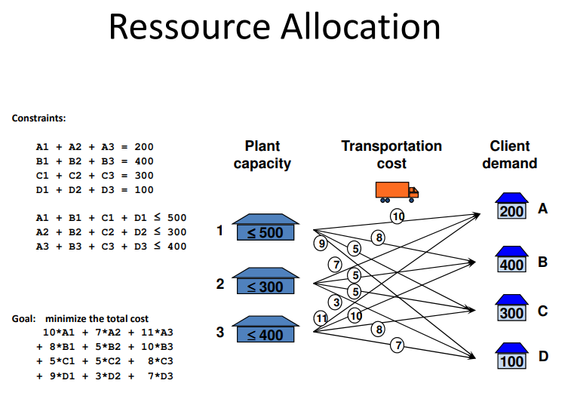
Examples
4 Feb 2004
CS 3243 - Constraint Satisfaction

Slide 14
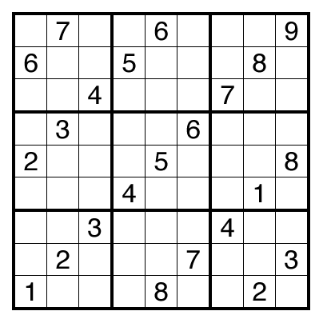
Examples - Soduku
4 Feb 2004
CS 3243 - Constraint Satisfaction

Slide 15
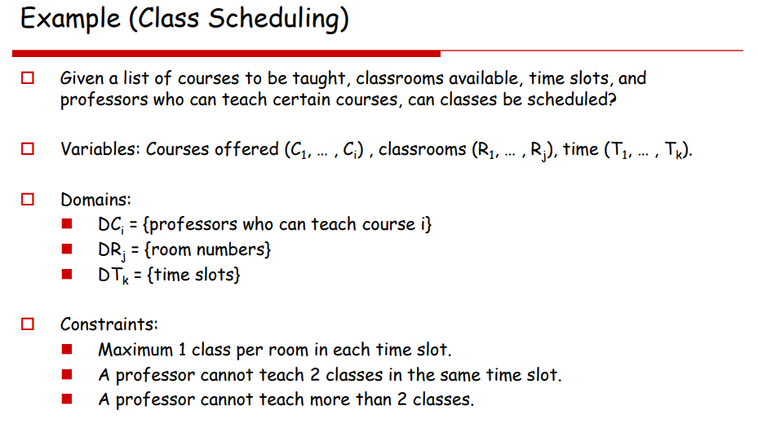
4 Feb 2004
CS 3243 - Constraint Satisfaction

Slide 16
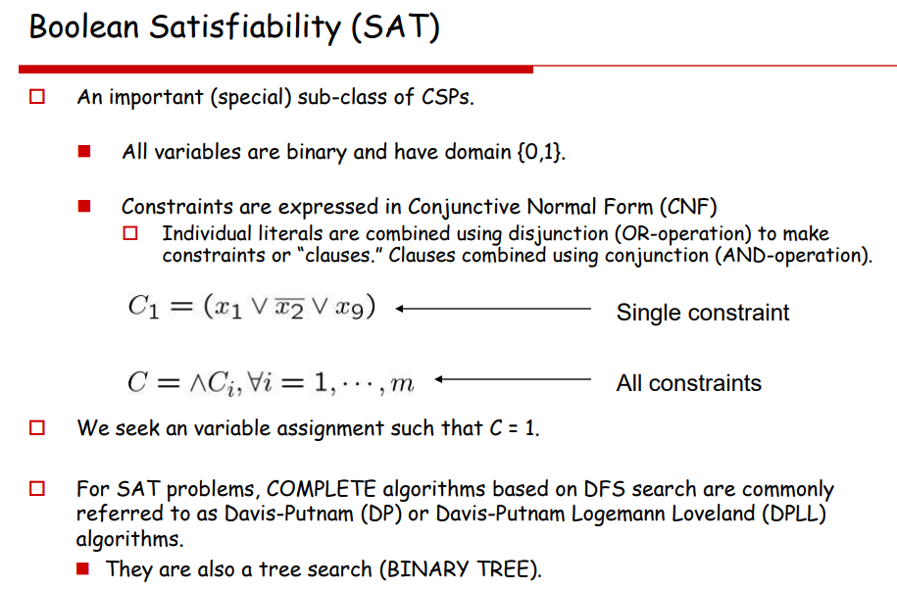
4 Feb 2004
CS 3243 - Constraint Satisfaction

Slide 17
Job-shop scheduling
Consider a small part of the car assembly, consisting of 15 tasks: install axles (front and back), affix all four wheels (right and left, front and back), tighten nuts for each wheel, affix hubcaps, and inspect the final assembly. Represent the tasks with 15 variables:
X = {Axle_{F}, Axle_{B}, Wheel_{RF}, Wheel_{LF}, Wheel_{RB}, Wheel_{LB}, Nuts_{RF}, Nuts_{LF}, Nuts_{RB}, Nuts_{LB}, Cap_{RF}, Cap_{LF}, Cap_{RB}, Cap_{LB}, Inspect}. The value of each variable is the time that the task starts.
Precedent constraints: Whenever a task T₁ must occur before task T₂, and T₁ take duration d₁ to complete. We add an arithmetic constraint of the form T₁ + d₁ ≤ T₂ . So,
Axle_{F} + 10 ≤ Wheel_{RF} ; Axle_{F} + 10 ≤ Wheel_{LF} ; Axle_{B} + 10 ≤ Wheel_{RB} ; Axle_{B} + 10 ≤ Wheel_{LB} ; Wheel_{RF} + 1 ≤ Nuts_{RF} ; Wheel_{LF} + 1 ≤ Nuts_{LF} ; Wheel_{RB} + 1 ≤ Nuts_{RB} ; Wheel_{LB} + 1 ≤ Nuts_{LB} ; Nuts_{RF} + 2 ≤ Cap_{RF} ; Nuts_{LF} + 2 ≤ Cap_{LF} ; Nuts_{RB} + 2 ≤ Cap_{RB} ; Nuts_{LB} + 2 ≤ Cap_{LB} ;
Disjunctive constraint: Axle_{F} and Axle_{B} must not overlap in time. So,
( Axle_{F} + 10 ≤ Axle_{B} ) or ( Axle_{B} + 10 ≤ Axle_{F} )
Assert that the inspection come last and takes 3 minutes. For every variable except Inspect we add a constraint of the form X + d_{X} ≤ Inspect.
There is a requirement to get the whle assembly done in 30 minutes, we can achieve that by limiting the domain of all variables:
Di = {1, 2, 3, …, 27}

Slide 18

Example: Cryptarithmetic
Variables: F T U W
R O X₁ X₂ X₃
Domains: {0,1,2,3,4,5,6,7,8,9}
Constraints: Alldiff (F,T,U,W,R,O)
  O + O = R + 10 · X₁
  X₁ + W + W = U + 10 · X₂
  X₂ + T + T = O + 10 · X₃
  X₃ = F, T ≠ 0, F ≠ 0
4 Feb 2004
CS 3243 - Constraint Satisfaction

Slide 19
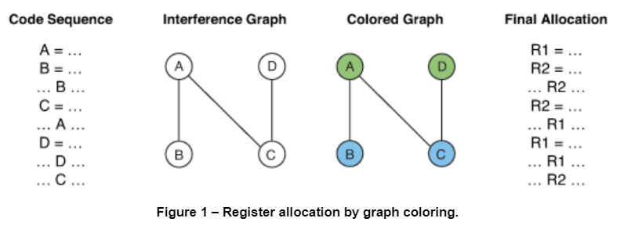
Register Allocation
4 Feb 2004
CS 3243 - Constraint Satisfaction

Slide 20
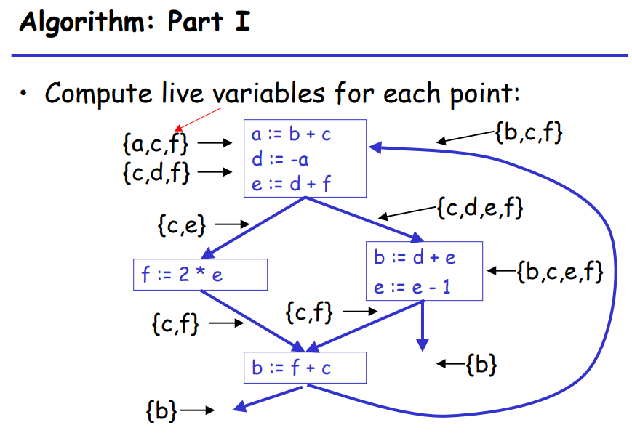
Register Allocation
4 Feb 2004
CS 3243 - Constraint Satisfaction

Slide 21
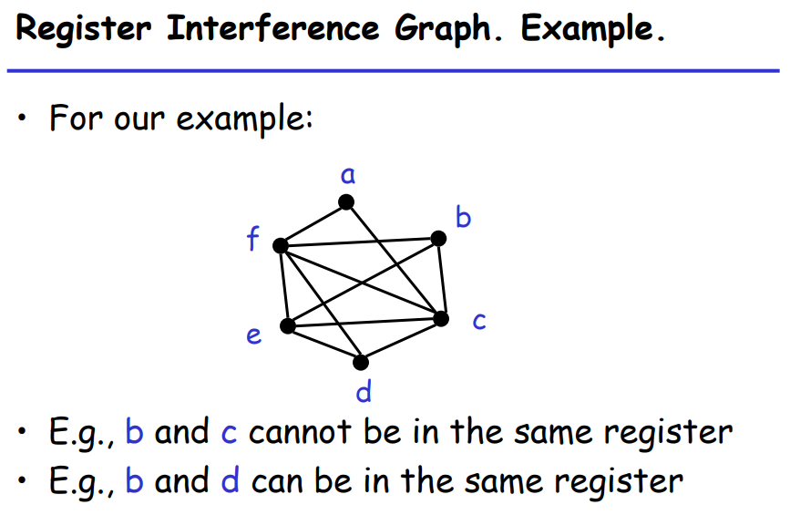
Register Allocation
4 Feb 2004
CS 3243 - Constraint Satisfaction

Slide 22
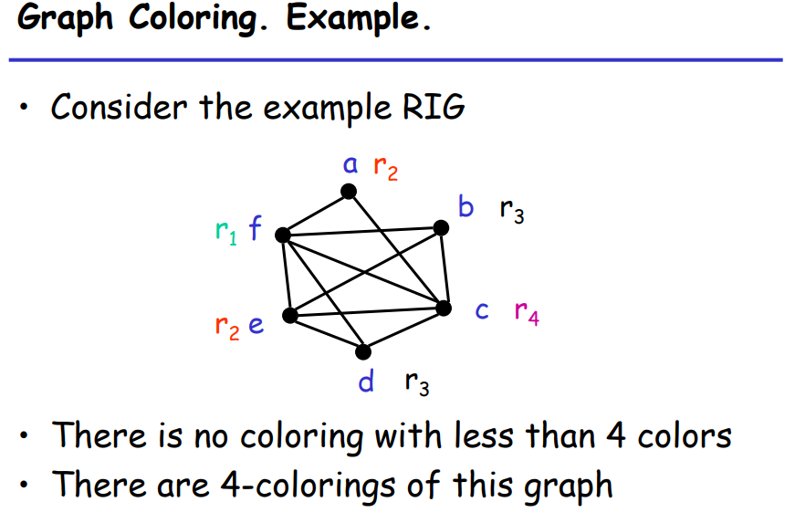
Register Allocation
4 Feb 2004
CS 3243 - Constraint Satisfaction

Slide 23
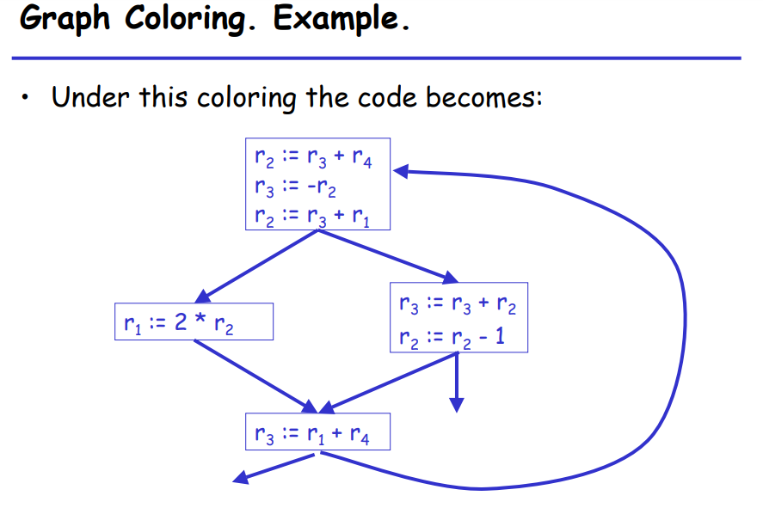
Register Allocation
4 Feb 2004
CS 3243 - Constraint Satisfaction

Slide 24
Real-world CSPs
Assignment problems
  e.g., who teaches what class
Timetabling problems
  e.g., which class is offered when and where?
Transportation scheduling
Factory scheduling
Notice that many real-world problems involve real-valued variables
4 Feb 2004
CS 3243 - Constraint Satisfaction

Slide 25
Standard search formulation (incremental)
Let's start with the straightforward approach, then fix it
States are defined by the values assigned so far
Successor function: assign a value to an unassigned variable that does not conflict with current assignment
  → fail if no legal assignments
Goal test: the current assignment is complete
This is the same for all CSPs
Every solution appears at depth n with n variables
→ use depth-first search
Path is irrelevant, so can also use complete-state formulation
b = (n - l )d at depth l, hence n! · d^{n} leaves
Initial state: the empty assignment { }
4 Feb 2004
CS 3243 - Constraint Satisfaction

Slide 26
Backtracking search
Variable assignments are commutative}, i.e.,
[ WA = red then NT = green ] same as [ NT = green then WA = red ]
Only need to consider assignments to a single variable at each node
  → b = d and there are $d^n$ leaves
Depth-first search for CSPs with single-variable assignments is called backtracking search
Backtracking search is the basic uninformed algorithm for CSPs
Can solve n-queens for n ≈ 25
4 Feb 2004
CS 3243 - Constraint Satisfaction

Slide 27

Backtracking search
4 Feb 2004
CS 3243 - Constraint Satisfaction

Slide 28

Backtracking example
4 Feb 2004
CS 3243 - Constraint Satisfaction

Slide 29

Backtracking example
4 Feb 2004
CS 3243 - Constraint Satisfaction

Slide 30

Backtracking example
4 Feb 2004
CS 3243 - Constraint Satisfaction

Slide 31

Backtracking example
4 Feb 2004
CS 3243 - Constraint Satisfaction

Slide 32
Improving backtracking efficiency
General-purpose methods can give huge gains in speed:
  Which variable should be assigned next?
  In what order should its values be tried?
  Can we detect inevitable failure early?
4 Feb 2004
CS 3243 - Constraint Satisfaction

Slide 33

Most constrained variable
Most constrained variable:
  choose the variable with the fewest legal values
a.k.a. minimum remaining values (MRV) heuristic
4 Feb 2004
CS 3243 - Constraint Satisfaction

Slide 34

Most constraining variable
Tie-breaker among most constrained variables
Most constraining variable:
  choose the variable with the most constraints on remaining variables
4 Feb 2004
CS 3243 - Constraint Satisfaction

Slide 35

Least constraining value
Given a variable, choose the least constraining value:
  the one that rules out the fewest values in the remaining variables
Combining these heuristics makes 1000 queens feasible
4 Feb 2004
CS 3243 - Constraint Satisfaction

Slide 36

Forward checking
Idea:
  Keep track of remaining legal values for unassigned variables
  Terminate search when any variable has no legal values
4 Feb 2004
CS 3243 - Constraint Satisfaction

Slide 37

Forward checking
Idea:
  Keep track of remaining legal values for unassigned variables
  Terminate search when any variable has no legal values
4 Feb 2004
CS 3243 - Constraint Satisfaction

Slide 38

Forward checking
Idea:
  Keep track of remaining legal values for unassigned variables
  Terminate search when any variable has no legal values
4 Feb 2004
CS 3243 - Constraint Satisfaction

Slide 39

Forward checking
Idea:
  Keep track of remaining legal values for unassigned variables
  Terminate search when any variable has no legal values
4 Feb 2004
CS 3243 - Constraint Satisfaction

Slide 40
Constraint propagation
Forward checking propagates information from assigned to unassigned variables, but doesn't provide early detection for all failures:
NT and SA cannot both be blue!
Constraint propagation repeatedly enforces constraints locally
4 Feb 2004
CS 3243 - Constraint Satisfaction

Slide 41

Arc consistency
Simplest form of propagation makes each arc consistent
X →Y is consistent iff
  for every value x of X there is some allowed y
4 Feb 2004
CS 3243 - Constraint Satisfaction

Slide 42

Arc consistency
Simplest form of propagation makes each arc consistent
X →Y is consistent iff
  for every value x of X there is some allowed y
4 Feb 2004
CS 3243 - Constraint Satisfaction

Slide 43

Arc consistency
Simplest form of propagation makes each arc consistent
X →Y is consistent iff
  for every value x of X there is some allowed y
If X loses a value, neighbors of X need to be rechecked
4 Feb 2004
CS 3243 - Constraint Satisfaction

Slide 44

Arc consistency
Simplest form of propagation makes each arc consistent
X →Y is consistent iff
If X loses a value, neighbors of X need to be rechecked
Arc consistency detects failure earlier than forward checking
Can be run as a preprocessor or after each assignment
for every value x of X there is some allowed y
4 Feb 2004
CS 3243 - Constraint Satisfaction

Slide 45
Arc consistency
the variables A and B are related by the constraint A<B. The assignment A=4 is inconsistent with each of the possible assignments to B because dom(B)={1,2,3,4}.
Delete {4} from A domain.
4 Feb 2004
CS 3243 - Constraint Satisfaction

Slide 46
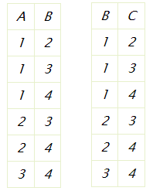
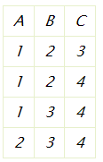
VARIABLE ELIMINATION
Example 4.24: Consider a CSP that contains the variables A, B, and C, each with domain {1,2,3,4}. Suppose the constraints that involve B are A<B and B<C. There may be many other variables, but if Bdoes not have any constraints in common with these variables, eliminating B will not impose any new constraints on these other variables. To remove B, first join on the relations that involve B:
4 Feb 2004
CS 3243 - Constraint Satisfaction

Slide 47

Arc consistency algorithm AC-3
Time complexity: O(n²d³)
4 Feb 2004
CS 3243 - Constraint Satisfaction

Slide 48
Local search for CSPs
Hill-climbing, simulated annealing typically work with "complete" states, i.e., all variables assigned
To apply to CSPs:
  operators reassign variable values
Variable selection: randomly select any conflicted variable
Value selection by min-conflicts heuristic:
choose value that violates the fewest constraints
i.e., hill-climb with h(n) = total number of violated constraints
allow states with unsatisfied constraints
4 Feb 2004
CS 3243 - Constraint Satisfaction

Slide 49

Example: 4-Queens
States: 4 queens in 4 columns (4⁴ = 256 states)
Given random initial state, can solve n-queens in almost constant time for arbitrary n with high probability (e.g., n = 10,000,000)
Actions: move queen in column
Goal test: no attacks
Evaluation: h(n) = number of attacks
4 Feb 2004
CS 3243 - Constraint Satisfaction

Slide 50
Summary
CSPs are a special kind of problem:
  states defined by values of a fixed set of variables
  goal test defined by constraints on variable values
Backtracking = depth-first search with one variable assigned per node
Variable ordering and value selection heuristics help significantly
Forward checking prevents assignments that guarantee later failure
Constraint propagation (e.g., arc consistency) does additional work to constrain values and detect inconsistencies
Iterative min-conflicts is usually effective in practice
4 Feb 2004
CS 3243 - Constraint Satisfaction

